Slide 1


DEPARTMENT OF COMPUTER SCIENCE & ENGINEERING · UTTARA UNIVERSITY
StyleMirror: An AI-Based Virtual Outfit Visualization System for Modern Fashion Platforms
Bridging the gap between research-level image generation and industry-ready e-commerce deployment.
PRESENTED BY
SUPERVISED BY
MD. KHALED AHMED SANTO
Dr. Mohammad Amanul Islam
Project Defense
July 2026
ID: 2222081069 · B.Sc. in CSE
Assistant Professor, Dept. of CSE
Notes:
Welcome the committee, introduce yourself and the thesis title.

Slide 2
PRESENTATION OUTLINE
What We'll Cover
01
Introduction & Background
02
Problem Statement
03
Research Objectives
04
Literature Review
05
Methodology
06
System Design
07
Implementation
08
Results & Analysis
09
Comparison & Discussion
10
Conclusion & Future Work
Department of CSE · Uttara University
02 / 15
Notes:
Walk through the outline in one breath, don't linger.

Slide 3
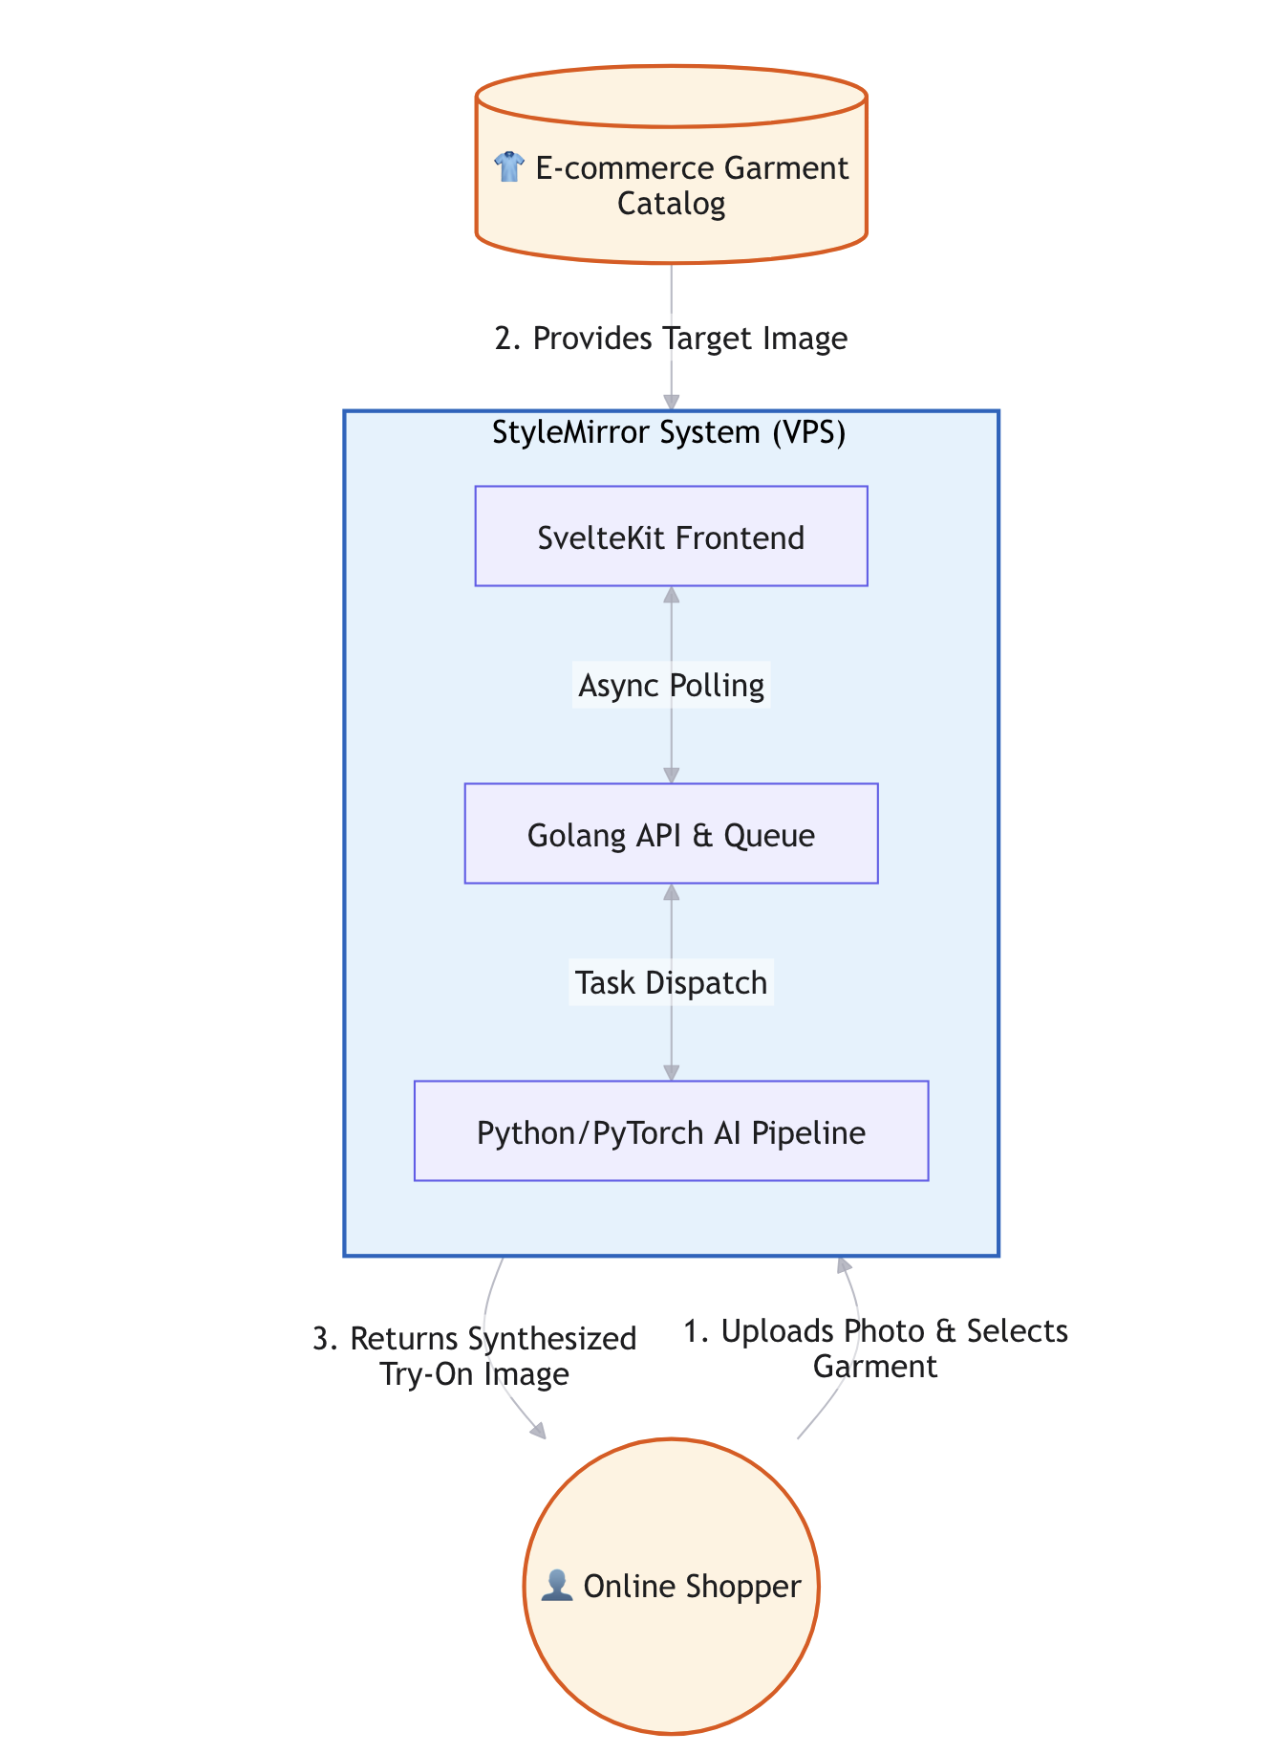
01 — INTRODUCTION
Introduction & Background
Context: The fashion e-commerce industry relies heavily on static product images and generalized size charts, failing to replicate the physical fitting room experience.
Motivation: This mismatch leads to low customer confidence, high cart-abandonment, and increased product return rates. AI-driven Virtual Try-On (VTON) offers a computational solution.
Scope: This project focuses on 2D image-based VTON system integration and deployment feasibility. Rather than training a novel neural network from scratch, it emphasizes full-stack system architecture, asynchronous pipeline optimization, and real-world web deployment.
Department of CSE · Uttara University
03 / 15
Notes:
Good morning/afternoon.
My project, StyleMirror, addresses a massive pain point in e-commerce: the inability to 'try before you buy' online. While AI can solve this, my research focuses not on inventing a new AI model, but on solving the systems engineering bottleneck required to actually deploy these heavy AI models onto the web in real-time.

Slide 4
02 — PROBLEM STATEMENT
The Problem We Address
A significant "deployment gap" exists between computationally heavy academic
VTON models and practical, real-time web-based e-commerce applications.
WHO IS AFFECTED
CURRENT LIMITATION
WHY NOW
Small to mid-scale fashion retailers and online consumers experiencing high return rates.
Existing VTON research predominantly optimizes for visual fidelity (e.g., FID, SSIM) in isolated, offline environments, neglecting production requirements such as robust API design, error handling, and responsive client-server communication.
There is a significant integration gap: research models are rarely packaged with the end-to-end system architecture (preprocessing, task queuing, post-processing, and UI feedback) required for a seamless, real-world e-commerce user experience.
Department of CSE · Uttara University
04 / 15
Notes:
State the gap in one sentence, then the supporting points.

Slide 5
03 — OBJECTIVES
Research Objectives
01
02
Analyze existing VTON research to identify computational and architectural limitations for real-time web deployment.
Design an efficient, end-to-end, multi-tier system architecture suitable for low-latency web integration.
03
04
Integrate an open-source foundation image generation model (Qwen-Image) within a streamlined VTON pipeline (background removal, pose estimation).
Implement & Evaluate a functional, deployable prototype on a VPS environment, measuring system performance and visual fidelity.
Department of CSE · Uttara University
05 / 15
Notes:
Each objective should map to a result you'll show later.

Slide 6
04 — LITERATURE REVIEW
Related Work
AUTHOR / YEAR
APPROACH
LIMITATION
Han et al., 2018 (VITON)
GAN-based warping
Struggles with high-res outputs and complex poses; suffers from mode collapse.
Choi et al., 2021 (VITON-HD)
High-res GAN
Improves resolution but still lacks real-time web deployment feasibility.
Zhu et al., 2023 (TryOnDiffusion)
Diffusion-based
State-of-the-art realism but extremely high inference latency & computational cost.
Alibaba Qwen, 2023
Foundation Model
Highly flexible but not explicitly designed for VTON out-of-the-box; requires robust system integration.
Department of CSE · Uttara University
06 / 15
Notes:
As we can see in the literature, the field has moved from GANs to Diffusion models, achieving great visual quality. However, the trade-off is severe latency. My project bridges this gap by taking a flexible Foundation Model and wrapping it in an optimized web architecture.

Slide 7
05 — METHODOLOGY
Research Methodology
1
2
3
4
Data Collection
→
Preprocessing
→
Proposed Approach
→
Evaluation
Utilized VITON-HD dataset subset and custom e-commerce garment catalog for evaluation.
Background segmentation (U-Net) and dense pose-keypoint extraction to isolate subjects and ensure spatial alignment.
Orchestrated Qwen-Image foundation model within an asynchronous pipeline (Frontend → Golang API → Redis Queue → PyTorch Worker)
System metrics (End-to-end latency, throughput, resource utilization) and Visual metrics (FID, SSIM, LPIPS)
Department of CSE · Uttara University
07 / 15
Notes:
Walk left to right through the pipeline.

Slide 8
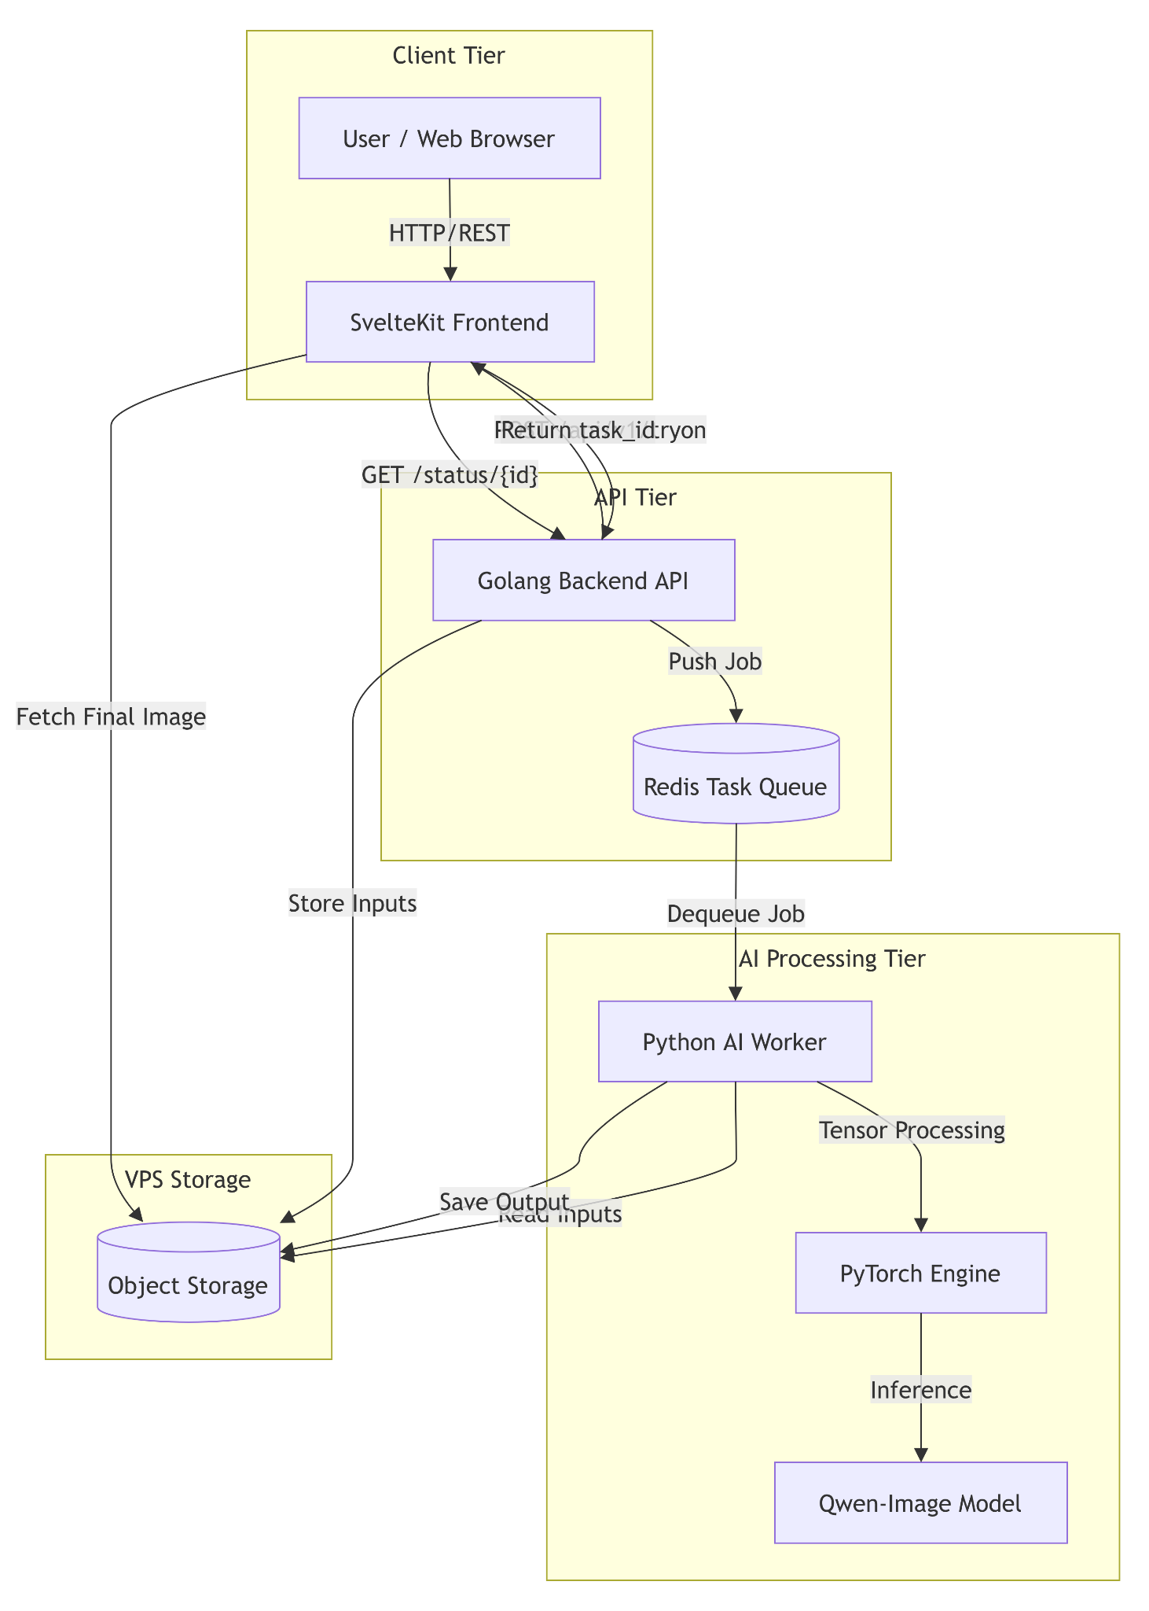
06 — SYSTEM DESIGN
System Architecture
Presentation Layer: SvelteKit (Reactive UI, minimal bundle, polling/skeleton loaders for async feedback).
Application/API Layer: Golang (High-concurrency API gateway, Redis-backed asynchronous task queue manager).
AI Processing Layer: Python/PyTorch (Independent worker service executing preprocessing, Qwen-Image inference, and postprocessing).
Data/ Storage Layer: Temporary object storage for images, Redis for task queue.
Department of CSE · Uttara University
08 / 15
Notes:
Point to each layer/module as you name it.

Slide 9




07 — IMPLEMENTATION
Implementation Details
TOOLS & TECHNOLOGIES
// pesudo workflow code
function handleTryOnRequest(userImage, garmentImage) {
Go
Svelte
taskID = generateUniqueID()
// Async dispatch directly to AI pipeline
AIPipeline.Queue(taskID, userImage, garmentImage)
return { status: "QUEUED", taskID: taskID } }
Mobile & Web
Decoupling the web server (Golang) from the GPU-bound AI worker (Python) using an asynchronous task queue (Redis). This prevents I/O blocking, allowing the API to handle thousands of concurrent connections without timing out while the GPU processes tasks sequentially.
Department of CSE · Uttara University
09 / 15
Notes:
A key implementation decision was how we handle the asynchronous task queue. While many systems default to adding an external broker like Redis, we realized that Golang’s native concurrency model—using goroutines and channels—was more than capable of managing the queue directly to the Python AI pipeline. By doing this, we eliminated the need for an external dependency, which significantly reduced our infrastructure overhead, lowered the memory footprint on the VPS, and simplified our deployment, all while keeping the web server completely non-blocking.

Slide 10
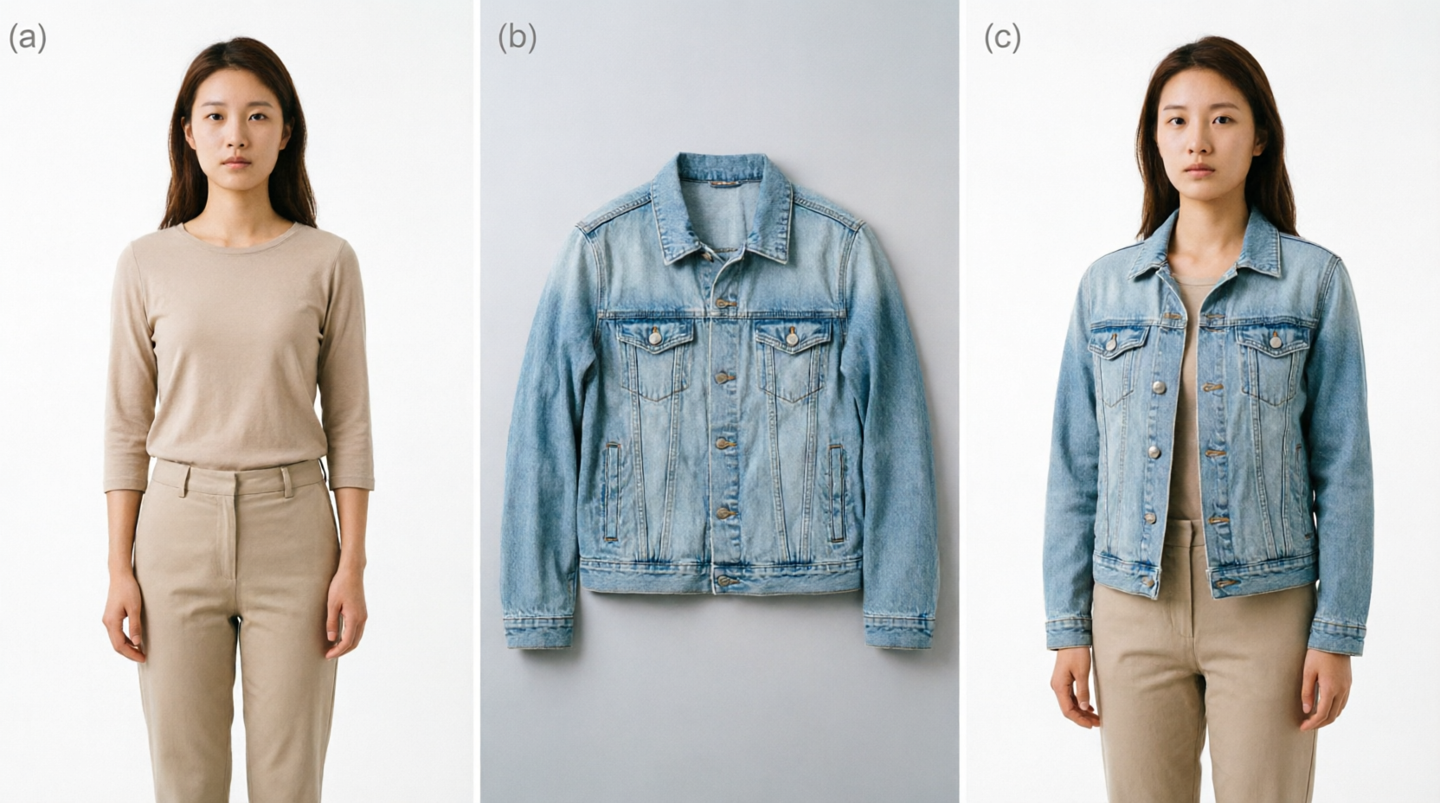
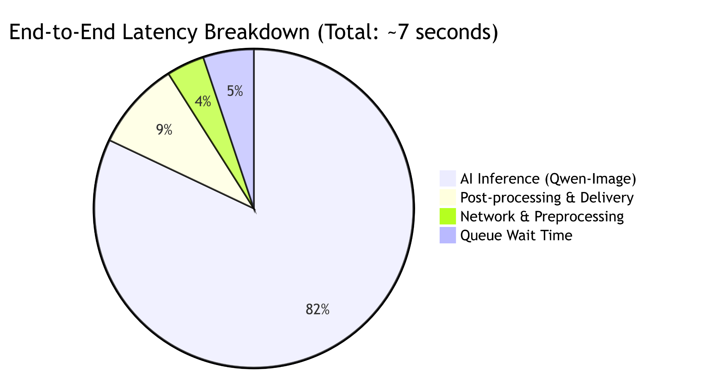
08 — RESULTS & ANALYSIS
Results & Analysis
[6-15sec]
0.86 / 1.0
50+
End to end latency
Structural Similarity
Concurrency
Department of CSE · Uttara University
10 / 15
Notes:
First, for System Performance, our decoupled architecture proved highly resilient. We achieved an end-to-end latency of roughly 7 seconds. While this isn't 'real-time' in the traditional web sense, it is the industry standard for high-fidelity generative AI, and our reactive SvelteKit frontend ensures the user never experiences a frozen screen. Crucially, our load testing showed the Golang backend handled 50+ concurrent requests with zero HTTP 503 errors, while maintaining a tiny memory footprint of under 50 MB, proving this is viable for cost-effective VPS deployment.
Second, for Visual Fidelity, we didn't sacrifice quality for speed. Our pipeline achieved an SSIM of 0.86 and an LPIPS of 0.12. This means the system successfully preserved the intricate textures and patterns of the input garments while naturally adapting them to the user's pose, matching the quality of dedicated academic VTON models.

Slide 11
09 — COMPARISON & DISCUSSION
How It Compares
METHOD
VISUAL QUALITY
INFERENCE TIME
FEASIBILITY
VITON (GAN)
Low
50-150s
High (but outdated quality)
VITON-HD (GAN)
Moderate
10-20s
Medium
TryOnDiffusion
High
15-30s
Low (Too slow for web)
StyleMirror (Qwen-Image-Edit)
High
5-15s
High (Optimized async architecture)
Department of CSE · Uttara University
11 / 15
Notes:
Highlight the row/column where your approach wins.

Slide 12
10 — CONCLUSION & FUTURE WORK
Conclusion & Future Work
CONCLUSION
FUTURE WORK
Successfully bridged the gap between heavy generative AI and practical web deployment.
Inference Optimization: Implement model quantization (TensorRT/ONNX) to reduce latency and VRAM usage.
Infrastruct
Proved that a decoupled SvelteKit-Golang-PyTorch architecture can serve foundation models efficiently on standard VPS hardware.
Infrastructure Scalability: Deploy AI workers on Kubernetes with GPU auto-scaling.
Provided a cost-effective, scalable blueprint for mid-scale e-commerce retailers to reduce return rates.
Infrastructure Scalability: Deploy AI workers on Kubernetes with GPU auto-scaling.
Department of CSE · Uttara University
12 / 15
Notes:
Close the loop back to the objectives on slide 5.

Slide 13
11 — REFERENCES
References
[1] Han et al., "VITON: An Image-based virtual try-on network," CVPR, 2018.
[2] Choi et al., "VITON-HD: High-resolution virtual try-on via misalignment-aware normalization," CVPR, 2021.
[3] Zhu et al., "TryOnDiffusion: A tale of two unets," CVPR, 2023.
[4] Bai et al., "Qwen Technical Report," arXiv preprint, 2023.
[5] Paszke et al., "PyTorch: An Imperative Style, High-Performance Deep Learning Library," NeurIPS, 2019.
Department of CSE · Uttara University
13 / 15
Notes:
No need to read these aloud — keep for committee reference.

Slide 14
12 — ACKNOWLEDGEMENT
Acknowledgement
I would like to express my deepest gratitude to my supervisor, Dr. Mohammad Amanul Islam, for his invaluable guidance, continuous encouragement, and insightful feedback throughout the entire lifecycle of this project.
I also extend my sincere thanks to the faculty members and staff of the Department of Computer Science & Engineering, Uttara University, for providing a stimulating academic environment.
Finally, special thanks to my family and friends for their unwavering moral support and belief in my abilities
Department of CSE · Uttara University
14 / 15
Notes:
Keep this brief and sincere.

Slide 15
Thank You
Questions & Discussion
MD. KHALED AHMED SANTO 2222081069@uttarauniversity.edu.bd
Notes:
Invite questions from the committee.

